Slide 1

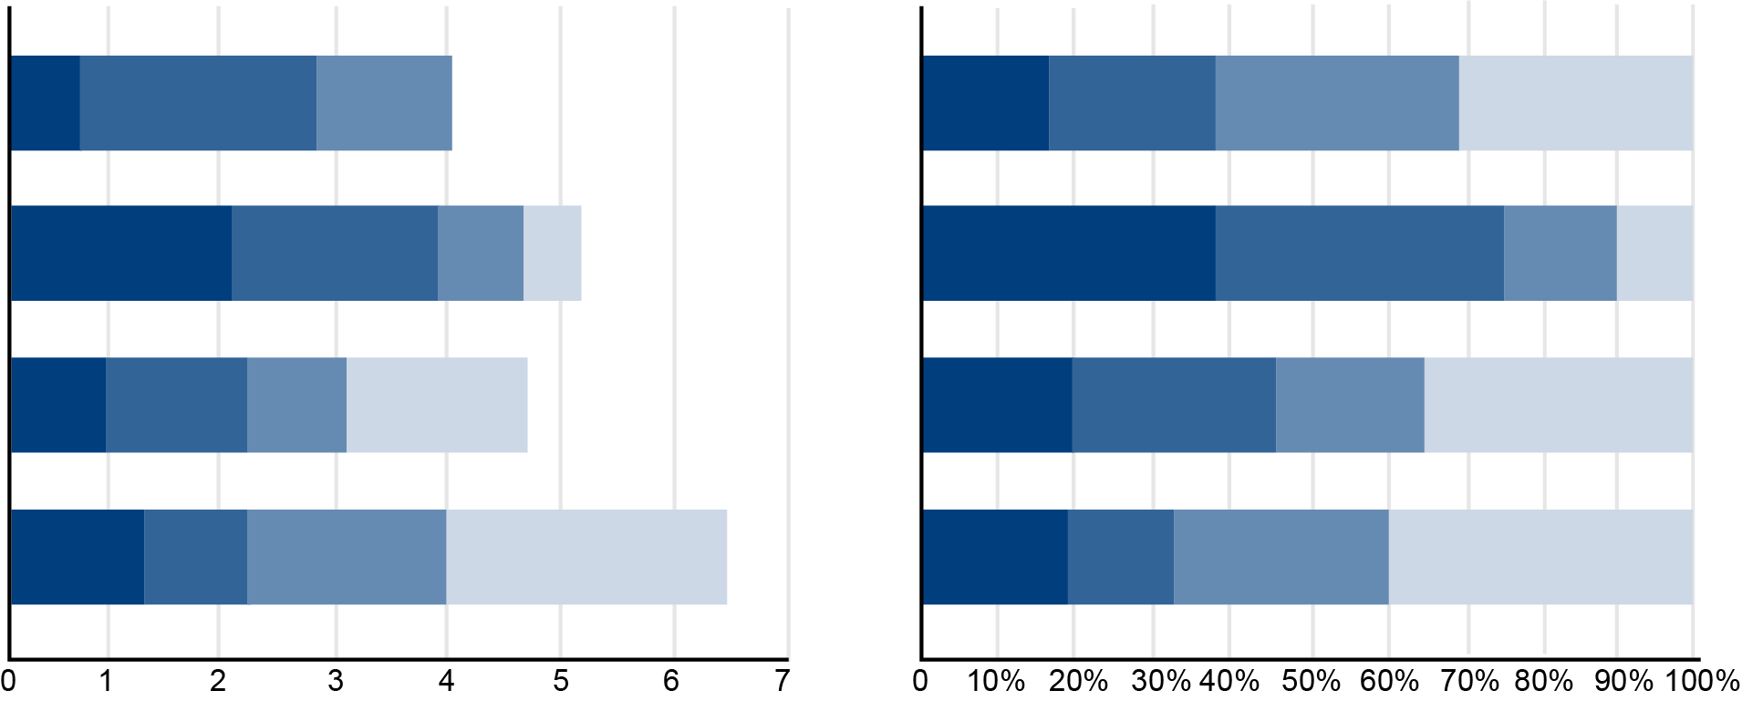
Connecting Drought Metrics:
Using PDSI to Predict USDM for Climate Risk Assessment
Delila Medlin, Nicholas McKay
College of Environment, Forestry, and Natural Sciences, Northern Arizona University, Flagstaff AZ, 86001
The Problem
Methods
In the US, the main metric used for drought measurement is the US Drought Monitor (USDM). The USDM is used for climate risk analyses, prediction
The data for both the USDM and PDSI were sourced from drought.gov, the National Integrated Drought Information System (NIDIS) official website. Measurements for the USDM are presented as percentages of land area that fall into a specific category of drought from D0 to D4. PDSI data is presented spatially as a NetCDF. To represent USDM percentages as a single value for modeling, we created a weighted average of the USDM at the county level. Gridded PDSI values along with their location in latitude and longitude were extracted and interpolated to align with USDM measurements. Finally. the dataset was trimmed, binning data points to the nearest degree of latitude and longitude to make the set manageable.
Info about modeling here
Abstract
Results
Drought is a major U.S. hazard directly affecting people and agriculture, whilst indirectly influencing risks like wildfires, heatwaves, and power outages. Despite these risks, drought is rarely integrated into risk analyses by insurance companies or land managers, partly due to its highly variable and contextual patterns. This project aims to develop a quantitative drought risk framework aligned with climate risk industry needs.
The U.S. Drought Monitor (USDM), the standard drought index in the U.S., ranks severity from D0 (Abnormally Dry) to D4 (Exceptional Drought) based on various measurements of precipitation, soil moisture, etc. However, USDM's limitations: only five indices, and limited range of data for 25 years-from 2000-present, provide insufficient understanding of long-term drought patterns, particularly as they shift due to climate change. To address this issue, we utilize the Palmer Drought Severity Index (PDSI), which ranges from -10 (Dry) to +10 (Wet), correlates strongly with USDM estimates, and can be reconstructed for over 1000 years using long-standing tree-ring data, along with other proxies
Modeling results here….
References
Acknowledgements

